Slide 1


Slide 2
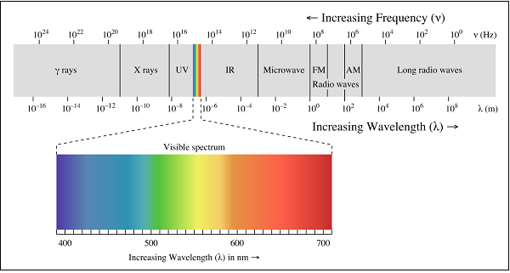

Slide 3
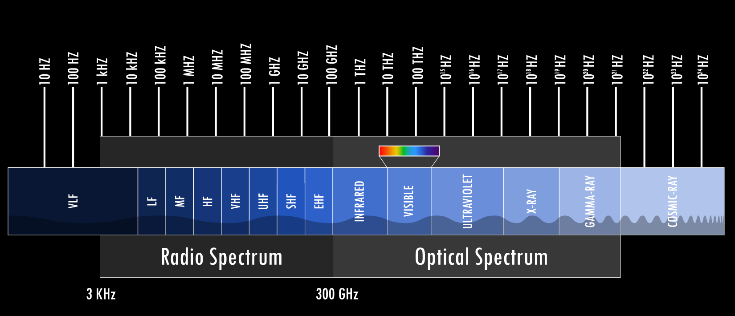

Slide 4
Transmitter
Receiver
ASK Modulation
ASK Demodulation
Data
+
Antena
Antena
Demodulator
Data
Carrier
Carrier
ASK: Amplitude-Shift Keying

Slide 5
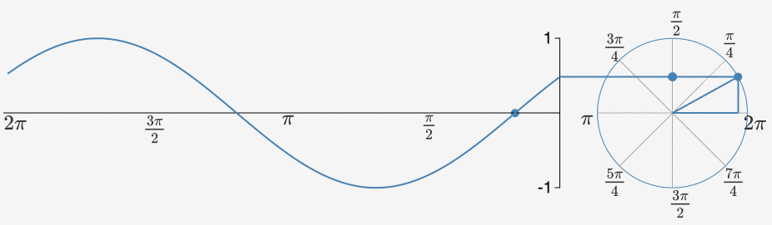
Carrier Signal
Asin(wt+θ) w=2πf

Slide 6
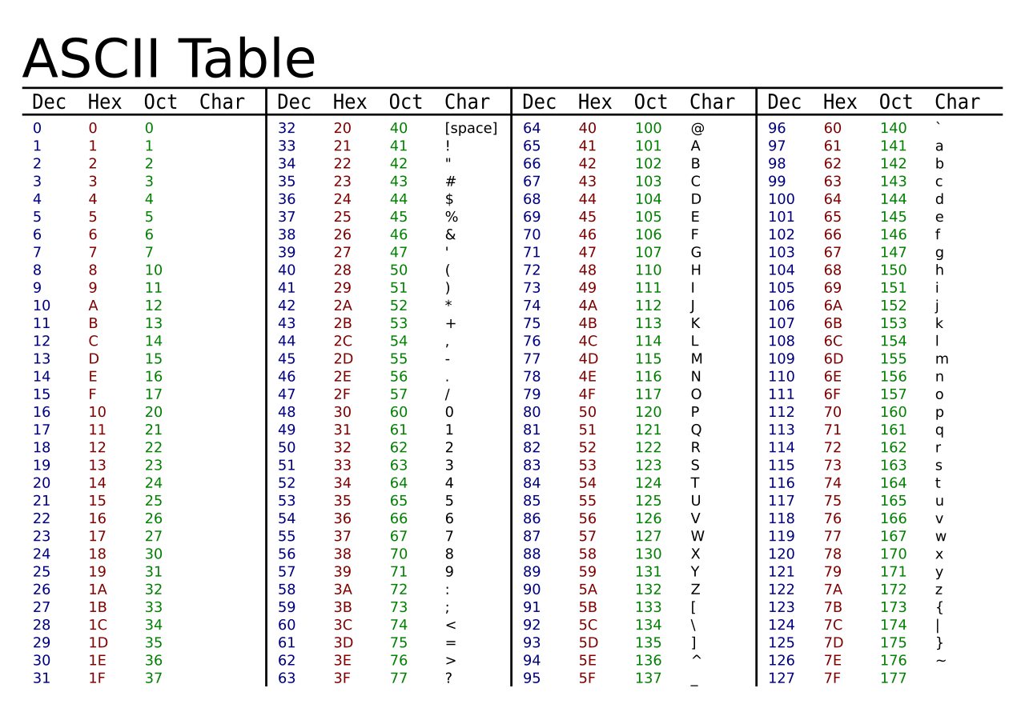
Data Signal
0x48
8
0100 1000
0 1 0 0 1 0 0 0

Slide 7
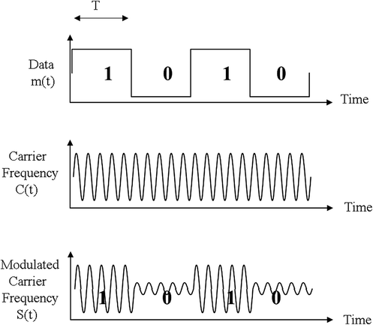
Hi
Transmitter
0x48 0x69
0100 1000 0110 1001
Data
+
Bandpass Filter
Antena
Carrier

Slide 8
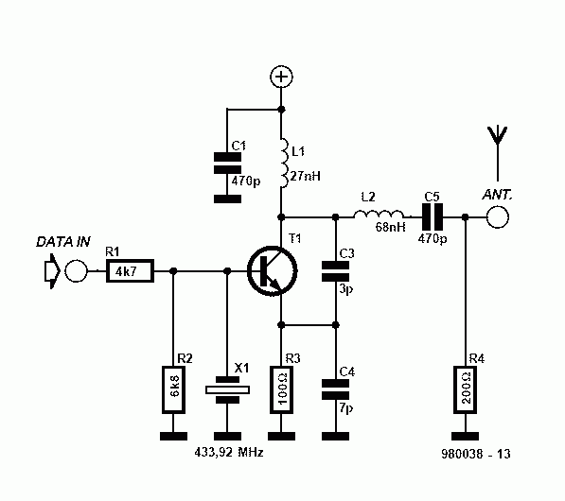

Slide 9
Receiver
Lowpass Filter
&
Rectifier
ASK Data
+
Noise
Sample
&
Hold
+
Demodulated
Data
Comparator
1
0
1
1
Vref

Slide 10
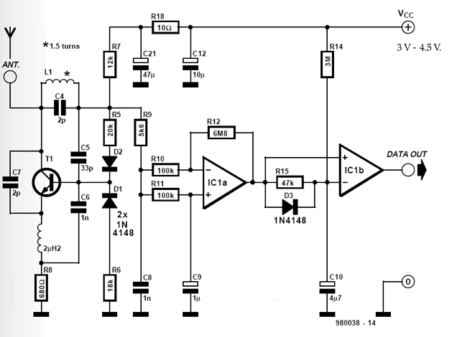

Slide 11
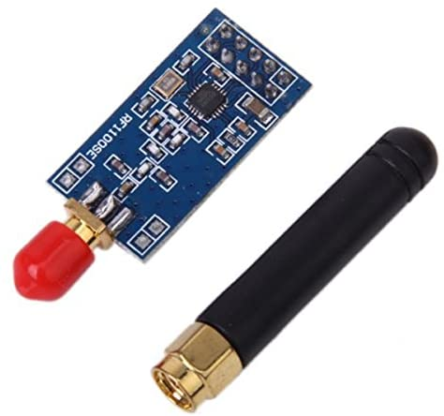
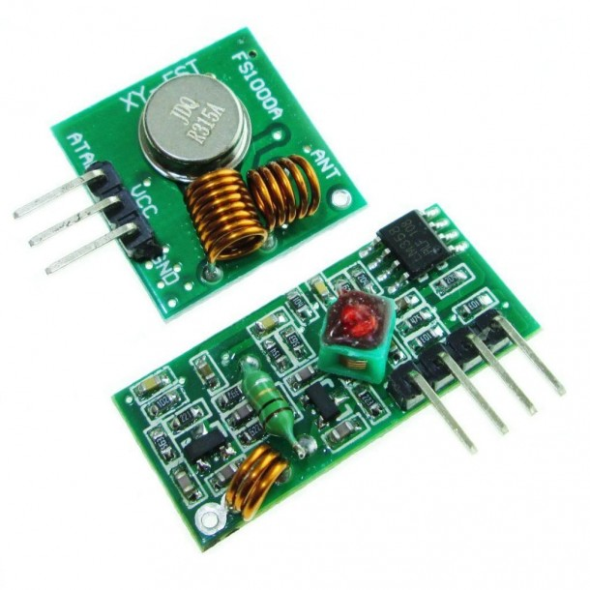
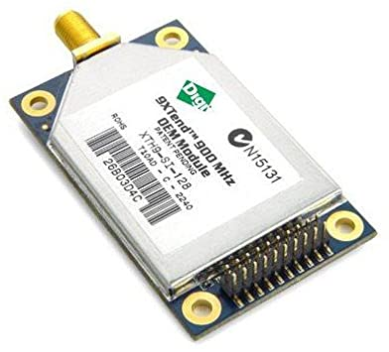
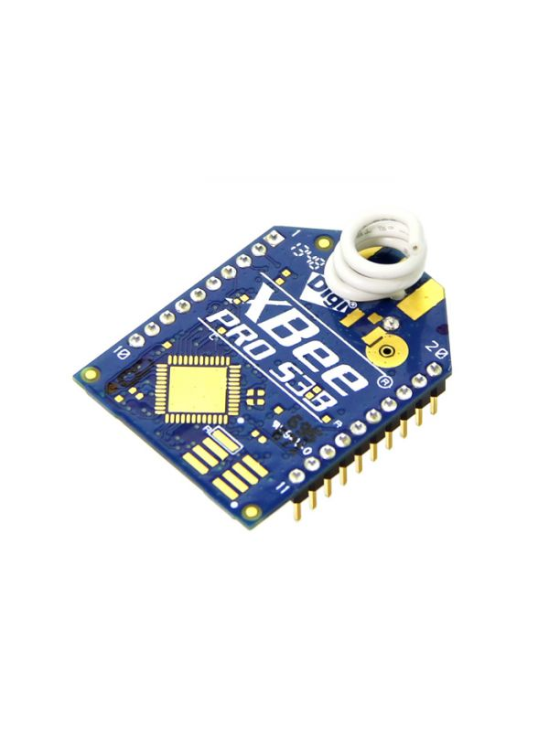
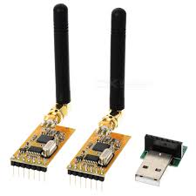
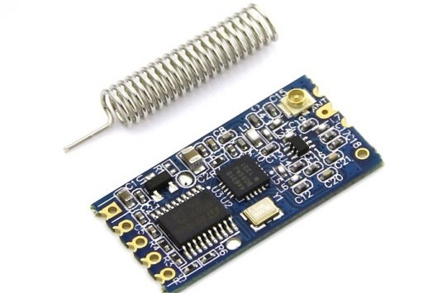

Slide 12
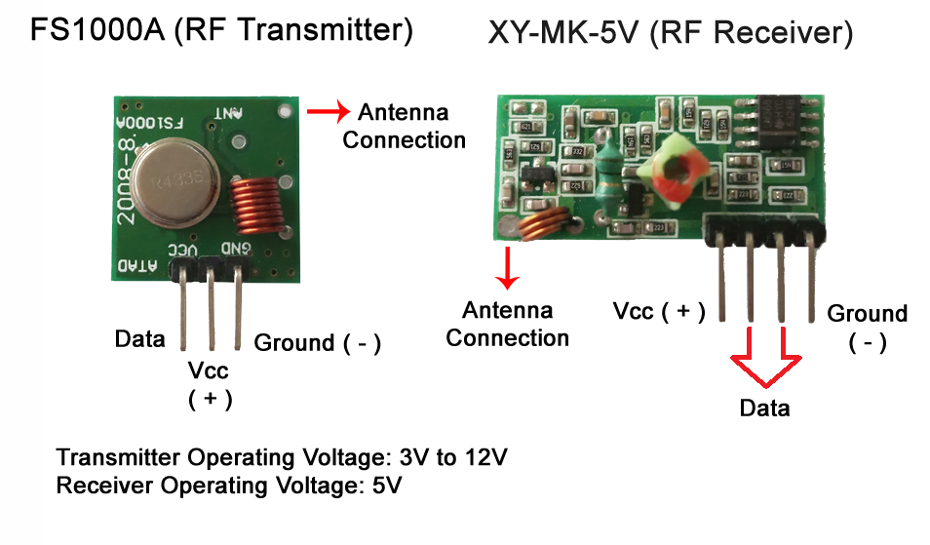
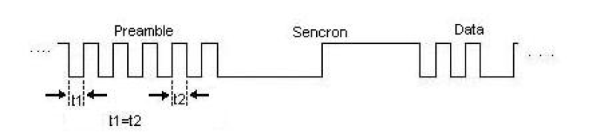
Sending and Receiving the Data
Manchester code
0 1 0 1 0 1 0 1 0 1 0 1 0 1 0 1 0 0

Slide 13
Teşekkürler

